Slide 1
Measuring the Latency of Depression Detection in Social Media
Speaker: Ming-Chieh, Chiang
Advisor: Jia-Ling, Koh
Source: WSDM’18
Date: 2018/07/10

Slide 2
Outline
Introduction
Method
Experiment
Conclusion

Slide 3
Motivation

Slide 4
Goal
Introduce a new metric for measuring the quality and speed at which a model identifies whether a user is depressed given a series of their social media posts

Slide 5
Outline
Introduction
Method
Experiment
Conclusion

Slide 6
Method
Features
Model
Evaluation metrics

Slide 7
Features

Slide 8
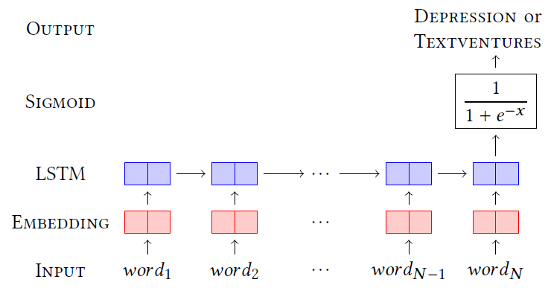
Features
DepEmbed

Slide 9
Model
Non-sequential (SVM)
Sequential (GRU)

Slide 10
Non-sequential Model
Summarize all the posts of a user

Slide 11
Sequential Model
Summarize one of the posts of a user

Slide 12
Prediction
Some occasional mistakes will force a early detection model to abort
Risk windows

Slide 13
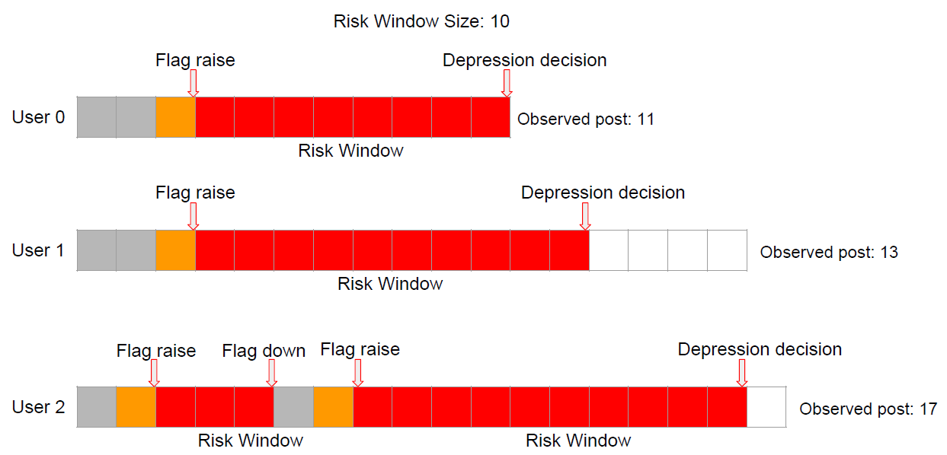
Prediction
Risk windows

Slide 14
Evaluation Metrics
Early Risk Detection Error (ERDE)
Latency and Latency-weighted F1

Slide 15
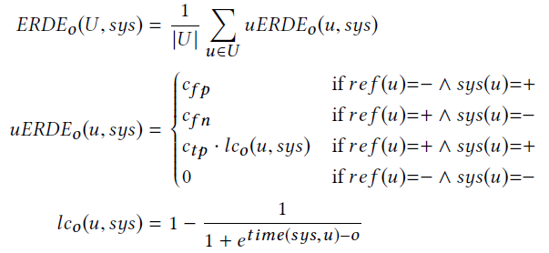
ERDE
Penalize systems that take too long to make a prediction

Slide 16
ERDE
Drawbacks:
-Many parameters must be set manually
-”How many posts should it take to detect
depression?”

Slide 17
Latency-weighted F1
Latency
Latency-weighted F1

Slide 18
Outline
Introduction
Method
Experiment
Conclusion

Slide 19
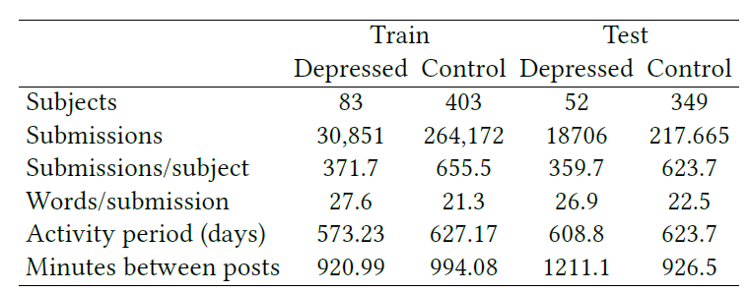
Data
Reddit (https://www.reddit.com/)

Slide 20
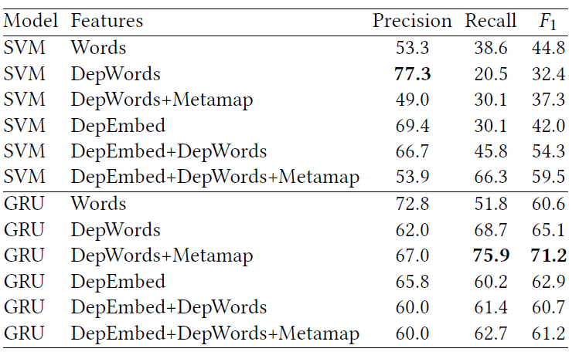
Model Selection

Slide 21
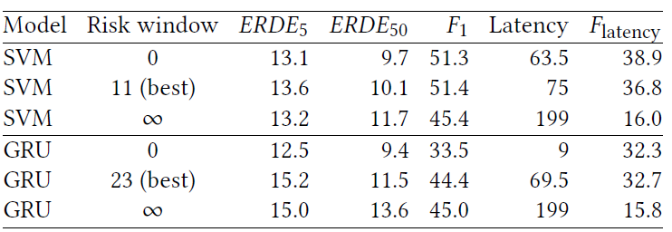
Evaluation

Slide 22
Outline
Introduction
Method
Experiment
Conclusion

Slide 23
Conclusion
Introduced latency and latency-weighted F1 as evaluation metrics for early detection tasks
Introduced the concept of risk windows
The proposed metrics can be useful in broad range of applications

